Slide 1
Employee Data Analysis using Excel
STUDENT NAME: MADHUMITHA.J
REGISTER NO: 2213371036218 (8E743C5F22966E6B313419DFFF367D27)
DEPARTMENT: COMMERCE
COLLEGE: Quaid-E-Millath Government College for Women (Autonomous)

Slide 2
PROJECT TITLE
Employee Performance Analysis using Excel

Slide 3


AGENDA
Problem Statement
Project Overview
End Users
Our Solution and Proposition
Dataset Description
Modelling Approach
Results and Discussion
Conclusion
3/21/2024 Annual Review

Slide 4

PROBLEM STATEMENT
* Identifying top performers: Performance reviews can help identify top performers and candidates for promotion.
*Increasing profitability: Performance reviews can help increase performance and profitability.

Slide 5

PROJECT OVERVIEW
.
Employee performance analysis is nothing but analysis the performance of the employee by considering various factors like Gender , Code , Ratings , Achievement's . In order to identify the trends and patterns of different categories of employee by their scores.

Slide 6
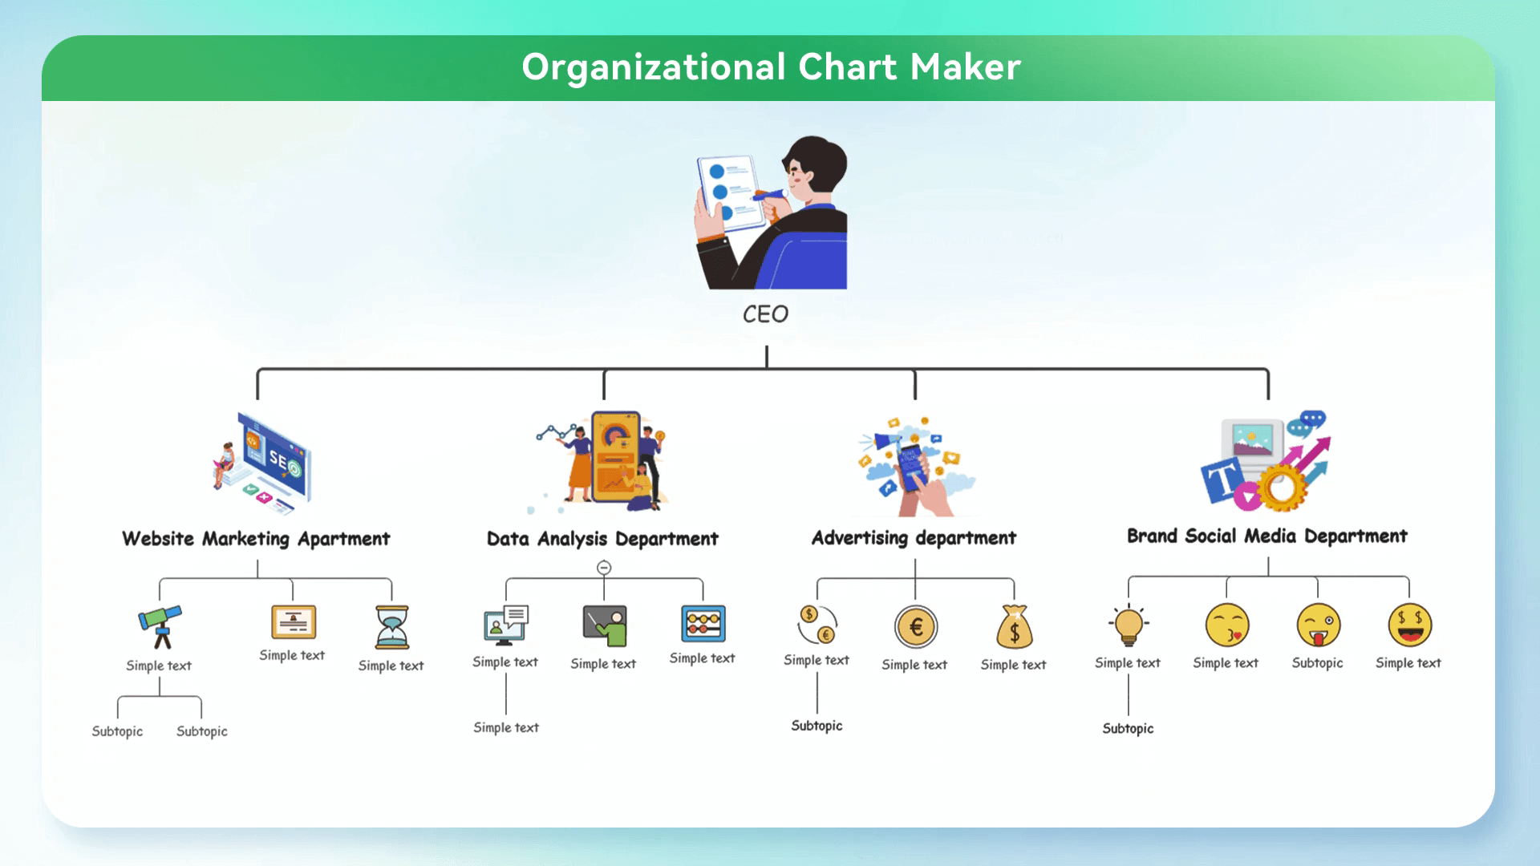
WHO ARE THE END USERS? Manager,Employees,Employer,Organisation,Industries, Various IT sectors etc.

Slide 7

OUR SOLUTION AND ITS VALUE PROPOSITION
Conditional Formatting – To highlight the missing values. Filter – To remove the missing values. Formula – To calculate the level of performance of employee. Pivot – Summary. Graph – For data visualization.

Slide 8
Dataset Description
Employee data set – Kaggle 9Features : * Employee ID No:
* Employee first name and last name in text * Employee type. * Performance level of employee. * Gender of employee. * Rating of employee in numericial value. * Starting and Exiting date of employee. * Email ID of an employee. * Business unit.

Slide 9

THE "WOW" IN OUR SOLUTION
*Our system automatically generates personalized development plans based on performance data, ensuring that each employee has a clear, actionable path for growth tailored to their unique strengths and areas for improvement. *Our solution goes beyond mere metrics. It combines advanced analytics with qualitative feedback to provide a holistic view of employee performance, ensuring that every data point is contextualized by human insights.
3/21/2024 Annual Review
9

Slide 10
MODELLING
Proactive Management: Enables prediction and early intervention for potential performance issues or attrition risks.
Personalization: Tailors development and retention strategies to individual employee needs.
Efficiency: Optimizes resource allocation for training, rewards, and management efforts
Data-Driven Decision-Making: Provides quantitative backing for HR decisions, reducing biases.
10

Slide 11
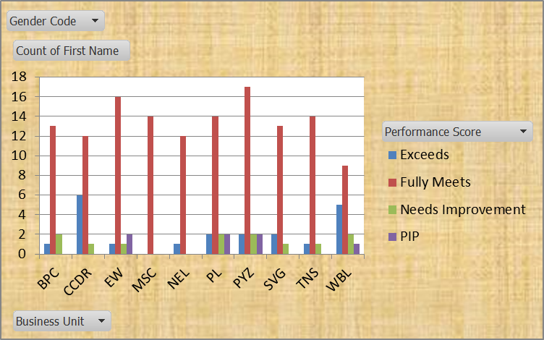
RESULTS
EMPLOYEE PERFORMANCE ANALYSIS
11

Slide 12
conclusion
Effective performance analysis fosters a culture of continuous improvement, where employees receive timely feedback, personalized development opportunities, and recognition for their achievements. This approach not only enhances individual performance but also drives overall organizational success by aligning employee goals with business objectives.

